Slide 1
Python Basics
Jesse Kaminsky

Slide 2
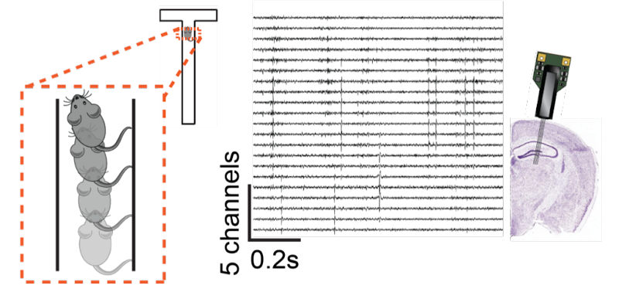

Slide 3
What is python and why do we use it?
Ultimately everything your computer is doing is manipulating a bunch of 0s and 1s which comprise its memory.
A programming language is just a way to tell your computer what you want it to do with its memory. Different languages operate at different “levels” of description. Python is a very high-level language, meaning it has wrapped up large chunks of commonly performed operations into short, understandable commands.
The set of all the rules python expects you to follow when issuing commands to the computer is the syntax of the language, and this varies from language to language.
We need programming languages and computers because I can’t look at the traces on previous slide and even tell you how many there are, let alone do nonlinear maximum likelihood estimation based latent variable modelling in my head.

Slide 4
I’m going to teach python 101
If you already know python, this may be boring for you. Feel free to work on other things. It’s also fine to leave, but here are some options of increasing difficulty.
Program tic-tac-toe before the end of the lecture
Solve some of these. (some of these are quite difficult, some are great practice)
Program a different game.
Train a model to predict the next value in the following sequence:
72,79,86,96,103,110,116,125,137,145,157,168,181,191 (solution in week 2)
Whatever you have to work on from your previous lab
Alternatively, you can help out those in your cohort with less programming experience, especially during the exercises.

Slide 5
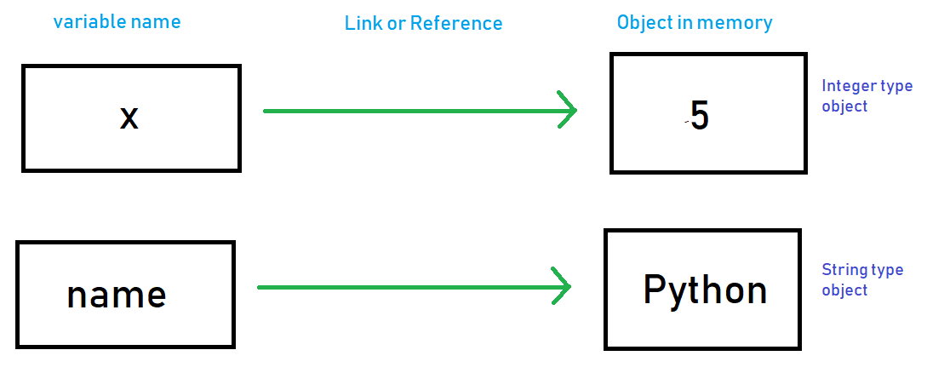

Slide 6
Good places for a refresher on basic python
https://docs.python.org/3/tutorial/introduction.html
(and the rest of the tutorial)
https://stackoverflow.com/questions
(for specific questions)
Random thread on difference between PCA and FA
https://stats.stackexchange.com/questions/123063/is-there-any-good-reason-to-use-pca-instead-of-efa-also-can-pca-be-a-substitut

